Slide 1
Perinatal Palliative Care
Sara Peeples, MD
Audrey Harris Neonatal Conference
September 11, 2014

Slide 2
“ The relief of suffering and the cure of disease must be seen as twin obligations of a medical profession that is truly dedicated to the care of the sick.” E. Cassell
Notes:
Sometimes continued medical intervention (though technically adequate) may not only fail to relieve suffering, but become a source of suffering itself (Cassell)
Recognize that there are some things we cannot fix or cure, but there is still much we can do
Suffering can be physical, mental, emotional
Frame of mind or attitudes of caregivers often more important to families than specific program details or services

Slide 3
Objectives
Overview of neonatal mortality
Understand the definition of palliative care
Understand the potential role of palliative care concepts in perinatal medicine
Review some practical applications in the NICU setting
Available national and local resources

Slide 4
Objectives
WHO
HOW
WHAT
WHY
WHERE
WHEN

Slide 5
Pediatric Mortality
Annual Summary of Vital Statistics 2008. Pediatrics 2011; 127:146-157.
Notes:
Annual Summary of Vital Statistics 2008 (published in 2011)
28,033 infant deaths; 22,844 deaths ages 1-19

Slide 6
Infant Mortality
US
Infant mortality: 6.59 per 1000 live births
Neonatal mortality: 4.27 per 1000 live births
Arkansas
Infant mortality: 7.35 per 1000 live births
Neonatal mortality: 4.38 per 1000 live births
Annual Summary of Vital Statistics 2008. Pediatrics 2011; 127:146-157.
Notes:
Annual Summary of Vital Statistics 2008 (published in 2011)
Infant: within first year of life
Neonatal within first 27 days
Does not include ~ 30,000 stillbirths that occur each year (7 fetal deaths per 1000 live births)
Despite all our advances in care, infants still die
US has higher IMR than 28 other industrialized countries

Slide 7
Infant Mortality
Annual Summary of Vital Statistics 2008. Pediatrics 2011; 127:146-157.
Notes:
Infant mortality is highest of any pediatric group (more children die in the first year of life than in all other years of childhood combined), and neonatal deaths (before day 28) comprise 2/3 of all infant deaths
2 largest categories are congenital malformations (including chromosomal abnormalities) and complications of low GA and low BWT
We can diagnose some congenital/genetic problems earlier, but still cannot treat/cure them
We have not yet been able to stop/prevent preterm labor and delivery

Slide 8
Death in the NICU: Who?
Previable
Periviable
Nonviable
Unresponsive to therapy
Unduly burdened
Notes:
Gestational age incompatible with survival (<23 weeks)
Gray zone where survival may be possible, but morbidity may be severe; significant uncertainty in prognosis (23-24 weeks)
Lethal anomalies, malformation, chromosomal abnormalities/defects
Deterioration despite maximal therapy, not responding to intensive care treatments (medical futility)
Unduly burdened (quality of life concerns); burden of continued treatment outweighs the benefits of prolonged life

Slide 9
Definitions: Viability
Capable of living, physically fitted to live
Having reached such a stage of development as to be capable of living, under normal conditions, outside the uterus
Capable of normal growth and development

Slide 10
Definitions: Viability
Viable ≠ Liveborn
Viable ≠ Response to Resuscitation
Notes:
The presence of a heartbeat does not mean the infant is able to survive
An initial response to resuscitation (or lack thereof) does not correlate to survival or morbidity

Slide 11
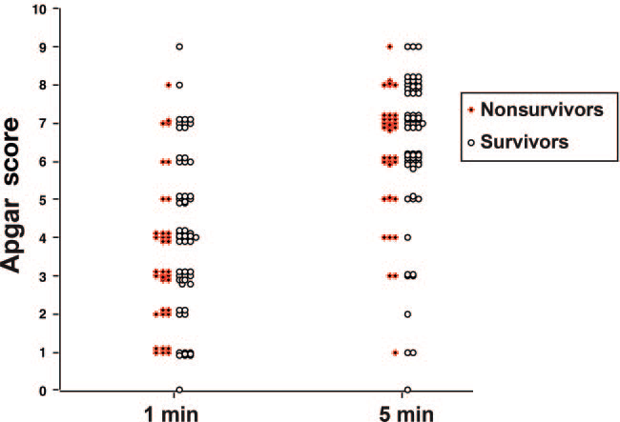
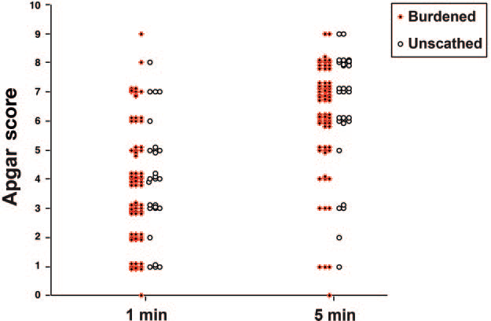
102 infants
BWT 640 ± 86g
GA 24.9 ± 1.5 weeks
Singh, et al. Pediatrics 2007; 120:519-26.
Notes:
102 infants, 65 survivors, 37 nonsurvivors
No Apgar score cut-off above which survival to discharge was assured or below which death was assured
70 burdened, 32 unburdened (neurologic abnormality vs intact neurologic survival); burdened defined as death or Mental Developmental Index or Psychomotor Developmental Index score of < 70 at 2 years adjusted age

Slide 12
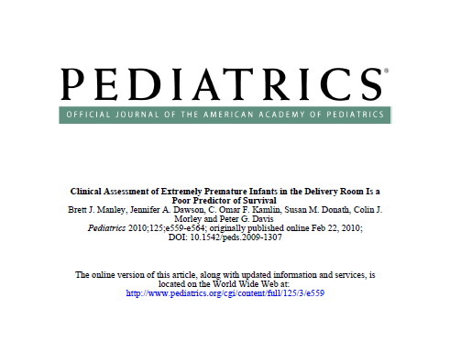

Slide 13
Death in the NICU: How?
Cook, Watchko. J Perinatology 1996
82% of NICU deaths occurred after decision to limit, withhold, withdraw treatment
Wall, Partridge. Pediatrics 1997
73% of deaths in the ICN attributable to withdrawal or withholding of life-sustaining treatment
Singh, Lantos. Pediatrics 2004
42% of NICU deaths involved active withdrawal of life-sustaining treatment
Notes:
Majority of neonatal deaths occur in the NICU; non-iniation, non-escalation, or active withdrawal of life-sustaining treatment
Cook: in 90% of these deaths the prognosis was poor and benefits of further treatment uncertain
Wall: 165 deaths over 3 year period; 108 followed withdrawal, 13 following withholding, 44 occurred while infants continued to receive maximal life-sustaining treatment; 74% of deaths attributable to withdrawing or withholding related to futility; quality of life concerns cited in 51%, and in 23% was the sole reason for withdrawing/withholding
Singh: 1988, 1993, 1998; half of the NICU deaths in 93 and 98 associated with “withdrawing or withholding”; >40% in 98 labeled as “active withdrawal” (extubation regardless of physiologic stability); active withdrawal occurred for medical futility (deterioration despite maximal intervention) and quality of life concerns (devestating neurologic injury—burdens of continued therapy outweighed benefits of prolonging life); also noted that death occurred in <10% of NICU admissions and <20% of ventilated admissions, and was predictable (2/3 in premature infants, 1/3 in larger infants with anomalies or asphyxia)

Slide 14
AAP Recommendations
When early death is very likely and survival would be accompanied by high risk of unacceptably severe morbidity, intensive care is not indicated
When survival is likely and risk of unacceptably severe morbidity is low, intensive care is indicated
For cases that fall in between these two categories, in which prognosis is uncertain but likely to be poor and survival may be associated with a diminished quality of life, parental desires should determine the treatment approach
Notes:
From AAP Statement “Noninitiation or Withdrawal of Intensive Care for High-Risk Newborns” Pediatrics 2007
Noninitiation and withdrawal are ethically the same

Slide 15
Misconceptions
Palliative care ≠ DNR
Palliative care ≠ hospice
Comfort care ≠ no treatment

Slide 16
Definitions: Palliative Care
Encompasses, but not synonymous with,
end of life care
Comprehensive care of the patient and family:
medical, psychosocial, emotional, and spiritual needs
Multidisciplinary team approach
Focus is on quality of life for the child and support for the family
Notes:
But not synonymous with end of life care; may be applied simultaneously with curative medical therapies, then intensify when curative therapies are no longer helpful or appropriate
Active, total care of patients whose disease is not responsive to curative therapy; the goal is the best quality of life for the patients and their families
Doctors, nurses, social workers, chaplains, child life specialists—no single profession can meet all the needs of a family
Active, total approach to care; truly family-centered care

Slide 17
Beyond End of Life Care
A
B
Gale, Brooks. Advances in Neonatal Care. 2006; 6: 37-53.
Notes:
(A) Traditional model with sharp demarcation between curative and palliative care
(B) Proposed model for children with life-threatening or life-limiting illnesses; supplementing curative therapies with palliative symptom management and psychosocial support to maximize the family’s ability to cope and improve the quality of time with their child
“Palliative care and cure-oriented or life-prolonging measures are not mutually exclusive, but may vary in emphasis along a patient’s disease trajectory or NICU course”

Slide 18
Goals of Perinatal Palliative Care
Provide appropriate medical therapy
Maximize quality of life
Ensure peaceful and dignified death
Support families through the illness,
death, and bereavement process
Notes:
Limit unnecessary treatment/use of technology that prolongs suffering, provide adequate treatment of symptoms
Pain-free and family-centered death for those neonates who cannot benefit from intensive care
Focus on the entire family; continuum of support from diagnosis through death and beyond

Slide 19
Aspects of Perinatal Palliative Care
Begins at the time of diagnosis
Alternative to pregnancy termination or
aggressive treatment in the NICU
Multidisciplinary care
Maternal-Fetal Medicine
Neonatology and other pediatric subspecialty staff
PalCare Team
Nursing, social work, child life, Pastoral care
Notes:
Early diagnosis of lethal or life-limiting anomalies/conditions (diagnosed by ultrasound, amnio)
High-risk OB (MFM), genetic counselors, ANGELS call center in communication with the primary/referring OB
Counseling and preparation regarding diagnosis and prognosis; most accurate information available; talking to other families may be helpful

Slide 20
Aspects of Perinatal Palliative Care
Routine prenatal care
Intrapartum management and
development of a birth plan
Plans for resuscitation and NICU care
Plans for discharge and subsequent follow-up
Notes:
Modifications of prenatal care (follow-up ultrasounds, waiting rooms, birthing classes)
Intrapartum: location, timing, mode of delivery; fetal monitoring; resuscitation and NICU care (start with plan for the infant; OB care should be consistent with goals for the infant and family)
Parents often do not feel validation/recognition of a perinatal loss; grieve the loss of their child, loss of the future; lack of support can complicate the mourning process

Slide 21
Candidates for Palliative Care
Stillborn infants
Infants at the limits of viability
Infants with lethal birth defects/anomalies
Infants with significant but non-lethal anomalies and/or life-limiting conditions
Infants unresponsive to ongoing intensive care,
or for whom such care is more burdensome than beneficial
Notes:
For stillbirth or fetal death, not allowing parents to see/hold the infant or providing visible rituals can “disenfranchise grief” and make the tragedy a “nonevent” and the loss a “nondeath”; very important to validate the loss
When continued intensive care only serves to prolong suffering; when cure is no longer a reasonable expectation or possibility
Questions: Is the underlying condition lethal? Does a refractory or chronic and debilitating condition exist for which there is little hope of long-term survival or the quality of such survival is arguable acceptable given the burden of continued interventions (severe BPD and respiratory failure)? Does multiple organ system failure exist (asphyxia or sepsis)? Is there an irreparable loss of vital tissue or organ function (severe short gut, IVH, PVL)? Can the patient’s condition reasonably be expected to be overcome with time and existing nutritional, medical, or surgical care?

Slide 22
Candidates for Palliative Care
Genetic/metabolic syndromes
Renal anomalies
CNS abnormalities, neuromuscular diseases
Cardiac disease
Structural anomalies
Notes:
Trisomy 13, 18; thanatophoric dwarfism; lethal forms of OI; Zellweger
Potter’s syndrome/renal agenesis
Anencephaly, holoprosencephaly, severe meningomyelocele/encephalocele, hydranencephaly, neurodegenerative diseases (SMA)
Inoperable heart lesions, some cases of HLHS, pentalogy of Cantrell
Giant omphalocele, diaphragmatic hernia (hypoplastic lungs), inoperable conjoined twins, limb/body/wall

Slide 23
Candidates for Palliative Care
Severe brain injury
Overwhelming sepsis
NEC and short gut
Severe lung disease
Unable to wean from ECMO
Notes:
Severe IVH, cystic PVL, HIE
Short gut making feeding/growth impossible

Slide 24
Important Considerations
Certainty of diagnosis
Certainty of prognosis
Mortality → potential lifespan
Morbidity → quality of life
Meaning of that prognosis to the family
Notes:
Acknowledge uncertainty, give a range of possibilities
Best interest of the child in the context of the family; some diagnoses may have treatment options that are deemed more burdensome than beneficial
Impact on the family unit (affects on the marriage, other children)

Slide 25
Care of the Periviable Infant
Accurate and consistent information
Balance honesty with hope
Joint decision-making
Trial of therapy may be reasonable
Notes:
Prognosis regarding death and morbidity is uncertain
Inform parents of expectations of survival and outcome, risks and benefits of various approaches to care, complications of prematurity and prolonged intensive care, possible long-term disabilities ; give the parents options; multiple conversations are optimal, but not always possible
National and local outcome data
Balance between appropriate information and hope, without giving “false hope”
Empathy and compassion are important to parents; how things are conveyed is often more important than what is said
Pay attention to the parents’ emotional and spiritual concerns
Communication and collaboration with parents and among healthcare providers

Slide 26
What Parents Need
Information
Clear, concrete, consistent, compassionate, timely
Involvement in decision-making
Control
Emotional support
Competent and compassionate medical care
Notes:
How the information is presented is almost as important as what is said; appropriate verbal and body language (avoid euphemisms and medical jargon); show images (compared to normal) when able; clear and direct information about prognosis, suffering; consistency among healthcare workers
humility is important to parents; acknowledge uncertainty; subtle physical contact; showing emotion
Communication and collaboration; mutually derived goals of care (start with the parents’ hopes and values, and determine which are realistic, which are unobtainable, and which may involve undue burden/suffering); understand parent preferences, how much direction/recommendation/guidance they want or need from the medical team
Must accept the condition of the infant before they can agree to withholding/withdrawing interventions
Takes time to reach a decision (pacing is important)
Parents need to ask questions, voice their opinions and concerns
Parents need choices/options, need to be involved in care
Every desired experience with their child that is possible; choosing the time of withdrawal
Parents focus on relationships with healthcare providers; they must trust the caregivers in order to trust the information they receive; parents trust providers when they feel that they care about them
Need to be assured that pain will be managed; need to know that providers are acting in the infant’s best interest
Support through the dying process and during bereavement (activities, resources)
Relieve parent guilt

Slide 27
Developing Goals of Care
The family is part of the medical team
Collaboration
Communication
Continued care and support
Notes:
Joint decision-making
Balance honesty with hope
Clear, consistent, and accurate
flexibility

Slide 28
The Words We Use
“Letting nature take its course”
“He/she is not responding to therapy”
“Non-escalation of care”
“There is nothing (more) we can do”
“Withdrawal of care”
“Withdrawal of support”
Let families know they will not be abandoned
Assure families we will continue to care for them and their infant
Notes:
We are not passively watching doing nothing, not “giving up”
There are many things that can and should be done for these families—emphasize what will be done, empower families to take control
Address the fears of lonliness, isolation, and suffering/pain for the infant
Active and comprehensive management of the entire patient, not abandonment of care when cure-oriented measures are no longer being offered

Slide 29
Levels of Comfort Care
Non-initiation of intensive care
Non-escalation of intensive care
Active withdrawal of life-sustaining treatment
Notes:
Comfort care, DNR, withholding additional treatments
extubation/withdrawal of mechanical ventilation
May occur in stepwise fashion as family comes to accept the infant’s condition and futility of further interventions

Slide 30
Aspects of Comfort Care
Location and environment
Symptom management
Meaningful rituals and memory-making
Respect for cultural and spiritual needs
Preparation and support for the family
Notes:
Local hospital vs tertiary care center; close to family and community support if possible; do not separate mothers and infants if possible
Discharge home with hospice if desired
Some infants able to be discharge home with appropriate support
Pain, anxiety, air hunger, seizures; remember also the post-partum needs of the mother
Baptism or other spiritual ceremonies, bathing, dressing, holding, hand molds and footprints, pictures, etc
Translators available, ethnic/cultural customs (handling the body, preparations for burial, organ/tissue donation and autopsy, etc)
Including grandparents, siblings, etc; prepare them for what they might see, hear, etc

Slide 31
Aspects of Comfort Care
Autopsy and organ donation
Milk donation
Bereavement support
Staff training and debriefing

Slide 32
Importance of Bedside Nurses
Interpret medical information
Day-to-day care of the infant
Relationships with the family
Creating memories
Notes:
Parents often ask nurses to clarify what the physicians have said
May ask questions of the bedside nurse (or share things) they are afraid to ask/tell the physician
Spend more time with the infant and family
Allow the parents to be parents (let them participate and be involved with the care of the infant)

Slide 33
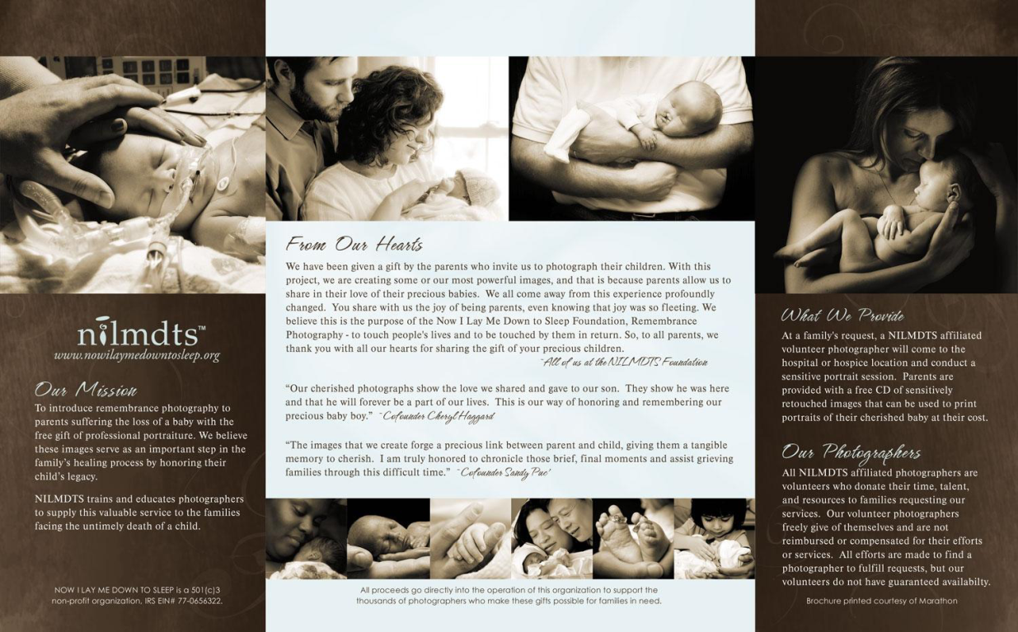

Slide 35
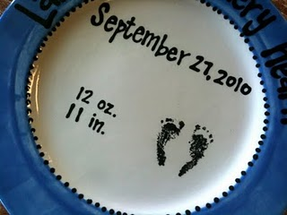
www.mamiespoppyplates.com

Slide 36
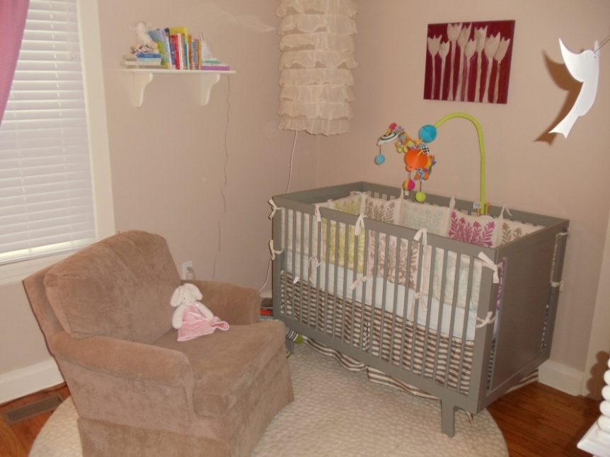
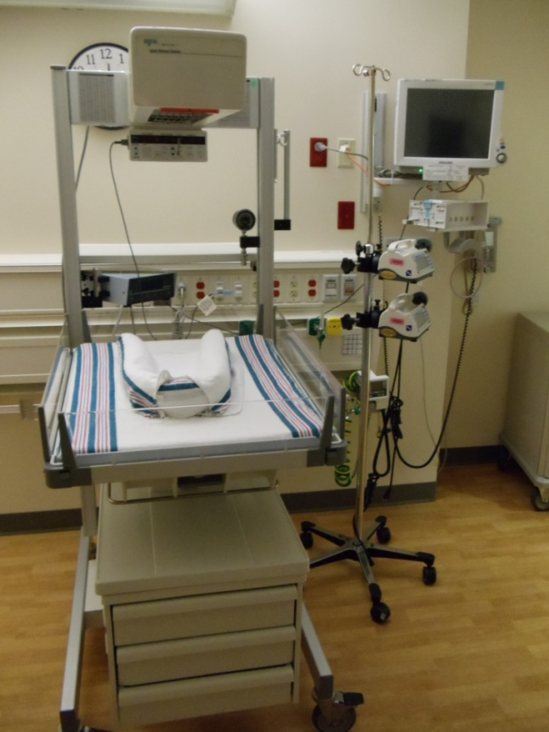
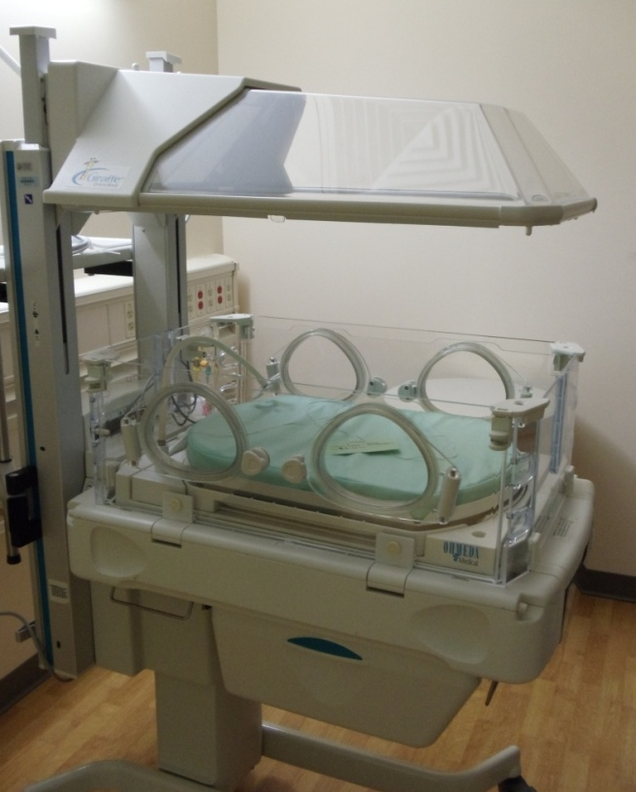
Notes:
Changing expectations

Slide 37
“ The goals of neonatal care may need to be expanded beyond seeking mere survival. Successful care also must include supporting a family in finding meaning in their baby’s life, however long that might be. Failure may be judged best not in mortality statistics, but in how much unnecessary suffering for infants and families remains unattended.”
Brian Carter. Neoreviews 2004; 5:e484-89.
Notes:
“Our goal is to add life to the child’s years, not simply years to the child’s life.” From the AAP Committee on Bioethics and Committee on Hospital Care statement on Palliative Care for Children; Pediatrics 2000; 106:351-57.
Emphasis on living fully in the time families have with their infants, however short that may be

Slide 38
Resources
www. goodmourningcenter.org
www.centering.org
www.bereavementservices.org
perinatalhospice.org
www.plida.org
www.aplacetoremember.com
www.compassionatefriends.org
www.nationalshare.org
www.facesofloss.com
www.stillstandingmag.com
www.modimes.org

Slide 39
Resources
Resolve through Sharing
National Hospice and Palliative Care Organization, www.nhpco.org
Circle of Life Hospice,
www.nwacircleoflife.com

Slide 40
Resources
Holistic care of the child
Support of the family
unit
Involvement of the
family in decision-making
and care planning
Relief of pain
Continuity of care
Grief and bereavement
support
The Initiative for Pediatric Palliative Care
www.ippcweb.org

Slide 41
Resources
Arkansas Fetal Diagnosis and Management Program
Lori Gardner, 501-296-1745 ext 1410
Lgardner@uams.edu
ANGELS call center
1-866-273-3835
http://angelsguidelines.com
Prenatal Counseling
Perinatal Palliative Care
Notes:
Counseling at extremely low gestational ages and for fetuses with congenital anomalies

Slide 42
Resources
Neonatology consults
1-800-ACH-HELP
501-364-6429
ACH PalCare Team
501-364-6658

Slide 43
References
The Dying Neonate:
Family-Centered End-of-Life Care
Martine De Lisle-Porter, RNC, MN
Ann Marie Podruchny, RNC, MN
Neonatal Network. 2009; 28(2):75-83

Slide 44
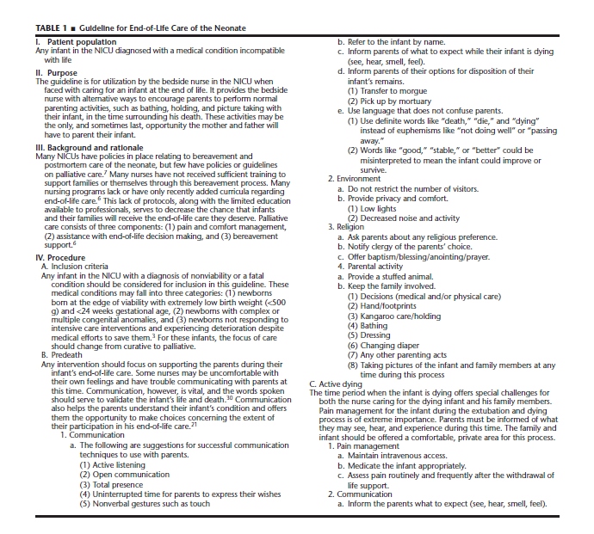

Slide 45
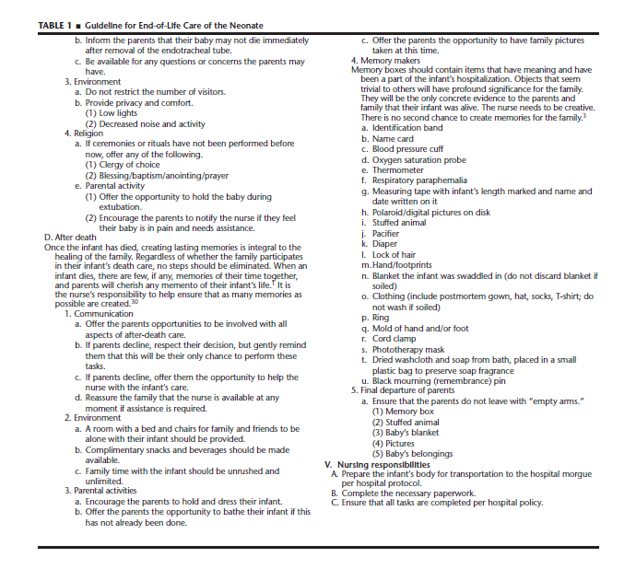

Slide 46
References
Mathews TJ, Minino AM, Osterman MJK, Strobino DM, Guyer B. Annual summary of vital statistics 2008. Pediatrics 2011;127(1):146-57.
Cook LA, Watchko JF. Decision making for the critically ill neonate near the end of life. J Perinatol 1996;16(2Pt1):133-6.
Wall SN, Partridge JC. Death in the intensive care nursery: physician practice of withdrawing and withholding life support. Pediatrics 1997;99:64-70.
Singh J, Lantos J, Meadow W. End-of-life after birth: death and dying in a neonatal intensive care unit. Pediatrics 2004;114(6):1620-6.
American Academy of Pediatrics Committee on Fetus and Newborn, Bell EF. Noninitiation or withdrawal of intensive care for high-risk newborns. Pediatrics 2007;119(2):401-3.
American Academy of Pediatrics Committee on Bioethics and Committee on Hospital Care. Palliative Care for Children. Pediatrics 2000;106(2):351-7.
Carter BS. Comfort care principles for the high-risk newborn. NeoReviews 2004;5(11):e484-90.

Slide 47
References
Brosig CL, Pierucci RL, Kupst MJ, Leuthner SR. Infant end-of-life care: the parents’ perspective. J Perinatol 2007; 27(8):510-6.
Catlin A, Carter B. Creation of a neonatal end-of-life palliative care protocol. J Perinatol 2002;22(3):184-95.
Gale G, Brooks A. Implementing a palliative care program in a newborn intensive care unit. Adv Neonatal Care 2006;6(1):37-53.
Gold KJ. Navigating care after a baby dies: a systematic review of parent experiences with health providers. J Perinatol 2007; 27(4):230-7.
Leuthner S, Jones EL. Fetal Concerns Program: a model for perinatal palliative care. MCN Am J Matern Child Nurs 2007;32(5):272-8.
Leuthner SR. Palliative care of the infant with lethal anomalies. Pediatr Clin North Am 2004;51(3):747-59, xi.
Leuthner SR. Fetal palliative care. Clin Perinatol 2004;31(3): 649-65.

Slide 48
References
MacDonald H, American Academy of Pediatrics Committee on Fetus and Newborn. Perinatal care at the threshold of viability. Pediatrics 2002;110(5):1024-27.
Munson D, Leuthner SR. Palliative care for the family carrying a fetus with a life-limiting diagnosis. Pediatr ClinNorth Am 2007;54(5):787-98, xii.
Widger KA, WilkinsK. What are the key components of quality perinatal and pediatric end-of-life care? A literature review. J Palliat Care 2004;20(2):105-12.
Williams C, Munson D, Zupancic J, Kirpalani H. Supporting bereaved parents: practical steps in providing compassionate perinatal and neonatal end-of-life care. A North American perspective. Semin Fetal Neonatal Med 2008;13(5):335-40.
Singh, et al. Resuscitation in the “gray zone” of viability: determining physician preferences and predicting infant outcomes. Pediatrics 2007; 120:519-526.

